Slide 1
Credit Card Financial Insights
Power BI Project

Slide 2
Credit Card Transaction Insights
KPIs
The Total Revenue Generated is 57M
The Total Transaction Amount is 46M
The Total Interest Earned is 8M
The Total number of Transaction Counts is 667.2K

Slide 3
Men generated 54.73% of the revenue, amounting to $31M, followed by women, who generated 45.27% or $26M.
Q4 generated the highest revenue of $14.5M, with the greatest transaction count of 173.2K.
The Blue Card has been the most popular card category, generating $47M in revenue.
Other card categories have not been as popular among customers, with Silver generating only $6M, Gold $3M, and Platinum $1M.
Most customers use their cards to pay bills, generating $14M in revenue, followed by entertainment and fuel, each generating $10M.
We receive 52.80% of our revenue from the high-income group.
Our customers are mostly people who have graduated or completed high school.
Customers prefer to use the swipe method for their credit card transactions.

Slide 4
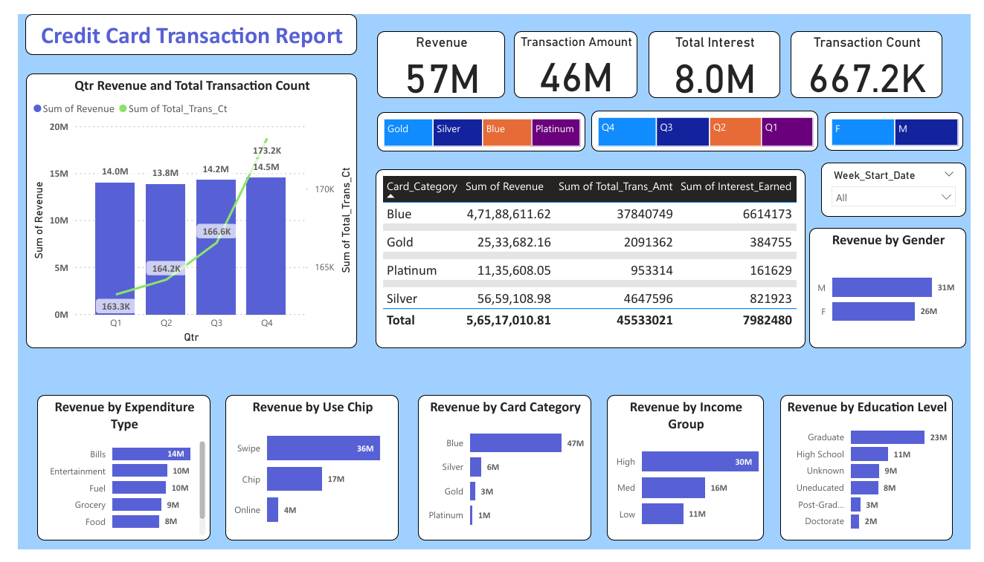

Slide 5
Credit Card Customer Insights
KPIs
The Total Revenue Generated is 57M
The Average Income of Customers is 57K
The Customer Satisfaction Score (CSS) is 3.2
The Customer count is 10.3K

Slide 6
The top three states that generate the most revenue are Texas, New York, and California, each generating $13M.
Customers between the ages of 40 and 50 generate the highest revenue, totaling $25M.
Married customers generate $29M in revenue, followed by singles, who generate $24M.
Most of our revenue is generated by customers who are businessmen or work in white-collar jobs.
Customers with two or three dependents generate the highest revenue.

Slide 7
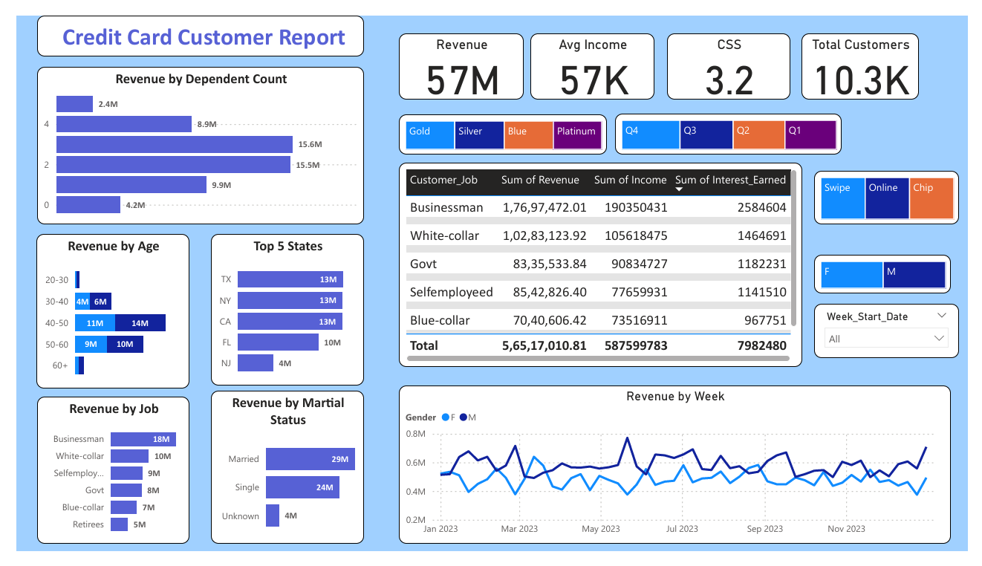

Slide 8
Next Steps
1. Target High Revenue Generating States:
Action: Increase marketing efforts in Texas, New York, and California.
Rationale: These states generate the most revenue, each contributing $13M. Enhanced marketing campaigns, promotions, and personalized offers in these states could further boost revenue.
2. Focus on Age Group 40-50:
Action: Develop targeted financial products and services for customers aged 40-50.
Rationale: This age group generates the highest revenue ($25M). Tailoring products such as premium credit cards, investment options, or retirement planning services to their needs could enhance engagement and revenue.

Slide 9
3. Enhance Services for Married Customers:
Action: Create family-oriented financial solutions and rewards programs.
Rationale: Married customers generate $29M in revenue. Offering family benefits, joint accounts with rewards for family spending, and financial planning services for families could attract more married customers and increase their spending.
4. Cater to Businessmen and White-Collar Professionals:
Action: Design exclusive credit card features for businessmen and white-collar professionals.
Rationale: These customer segments contribute significantly to revenue. Consider offering business travel perks, higher credit limits, and professional networking events to appeal to these customers.
5. Support Customers with Dependents:
Action: Introduce special benefits for customers with two or three dependents.
Rationale: Customers with dependents generate the highest revenue. Implement rewards for spending on education, healthcare, and family activities, and provide financial advice for managing family expenses.

